Slide 1
Računanje s drugim korijenom
Lidija Blagojević, prof. savjetnik

Slide 2
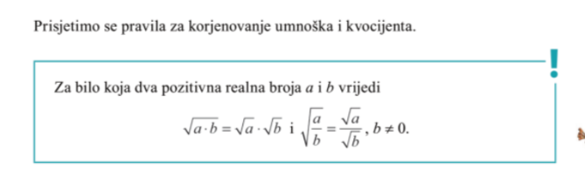
Korjenovanje umnoška i kvocijenta

Slide 3
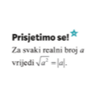
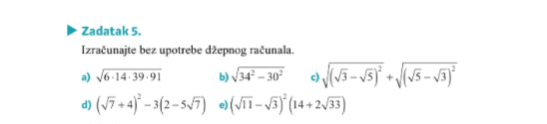
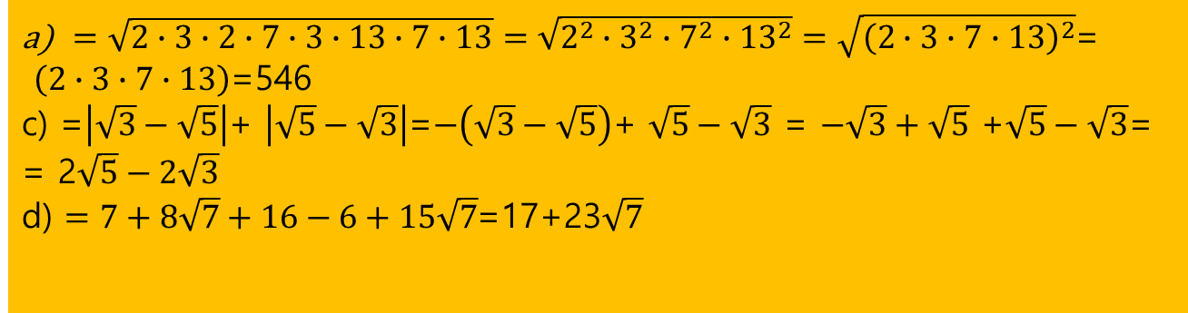
Zadatak 5 str. 14
DZ b i e
$=\sqrt{2∙3∙2∙7∙3∙13∙7∙13}=\sqrt{2^{2}∙3^{2}∙7^{2}∙{13}^{2}}=\sqrt{{\left(2∙3∙7∙13\right)}^{2}}$=
$\left(2∙3∙7∙13\right)$=546
c) =$\left|\sqrt{3}−\sqrt{5}\right|$+ $\left|\sqrt{5}−\sqrt{3}\right|$=$−\left(\sqrt{3}−\sqrt{5}\right)$+ $\sqrt{5}−\sqrt{3}$ = $−\sqrt{3}+\sqrt{5}$ +$\sqrt{5}−\sqrt{3}$=
= 2$\sqrt{5}−2\sqrt{3}$
d) $=7+8\sqrt{7}+16−6+15\sqrt{7}$=17+23$\sqrt{7}$

Slide 4
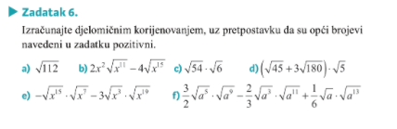
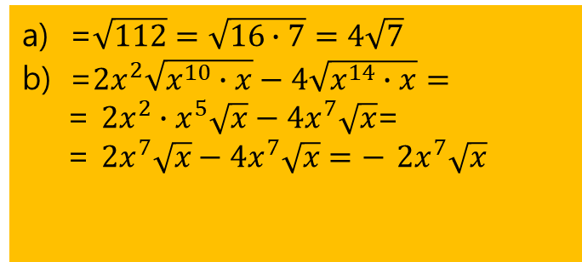
Zadatak 6. str 14 – djelomično korjenovanje
=$\sqrt{112}=\sqrt{16∙7}=4\sqrt{7}$
=$2x^{2}\sqrt{x^{10}∙x}−4\sqrt{x^{14}∙x}=$
= $2x^{2}∙x^{5}\sqrt{x}−4x^{7}\sqrt{x}$=
= $2x^{7}\sqrt{x}−4x^{7}\sqrt{x}=−$ $2x^{7}\sqrt{x}$
DZ c, d, e

Slide 5
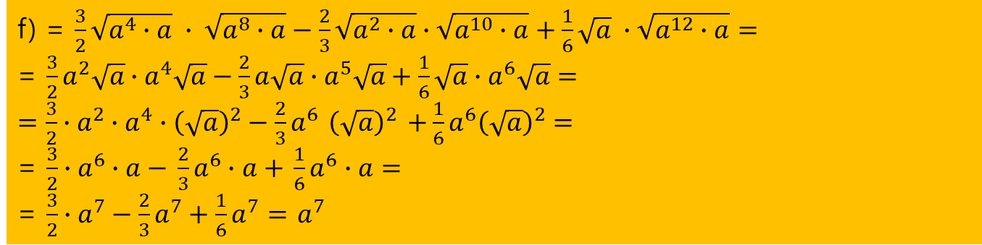
Zadatak 6. str 14 – djelomično korjenovanje
f) = $\frac{3}{2}\sqrt{a^{4}∙a} ∙ \sqrt{a^{8}∙a}−\frac{2}{3}\sqrt{a^{2}∙a}∙\sqrt{a^{10}∙a}+\frac{1}{6}\sqrt{a} ∙\sqrt{a^{12}∙a}=$
= $\frac{3}{2}a^{2}\sqrt{a}∙a^{4}\sqrt{a}−\frac{2}{3}a\sqrt{a}∙a^{5}\sqrt{a}+\frac{1}{6}\sqrt{a}∙a^{6}\sqrt{a}=$
$=\frac{3}{2}∙a^{2}∙a^{4}∙{\left(\sqrt{a}\right)}^{2}−\frac{2}{3}a^{6}$ ${\left(\sqrt{a}\right)}^{2}$ $+\frac{1}{6}a^{6}{\left(\sqrt{a}\right)}^{2}=$
= $\frac{3}{2}∙a^{6}∙a−$ $\frac{2}{3}a^{6}∙a+$ $\frac{1}{6}a^{6}∙a=$
= $\frac{3}{2}∙a^{7}−\frac{2}{3}a^{7}+\frac{1}{6}a^{7}=$ $a^{7}$

Slide 6
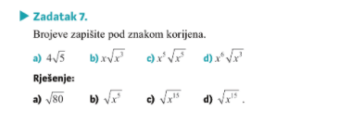
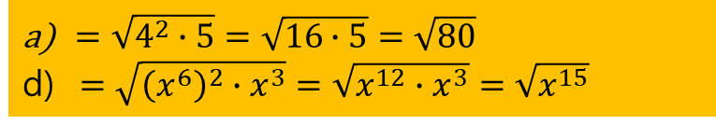
Zadatak 7 str 15 – uvođenje pod korijen
DZ b i c
$=\sqrt{4^{2}∙5}=\sqrt{16∙5}=\sqrt{80}$
d) $=\sqrt{{\left(x^{6}\right)}^{2}∙x^{3}}=\sqrt{x^{12}∙x^{3}}=\sqrt{x^{15}}$

Slide 7
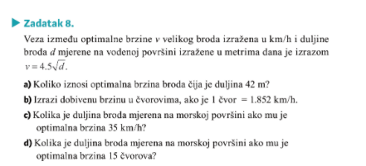
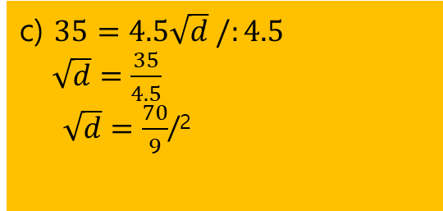

Zadatak 8 str 16 - primjena
a) b) d) za DZ
c) $35=4.5\sqrt{d} /:4.5$
$\sqrt{d}=\frac{35}{4.5}$
$\sqrt{d}=\frac{70}{9}$/²
$$d=60.5 m$$

Slide 8
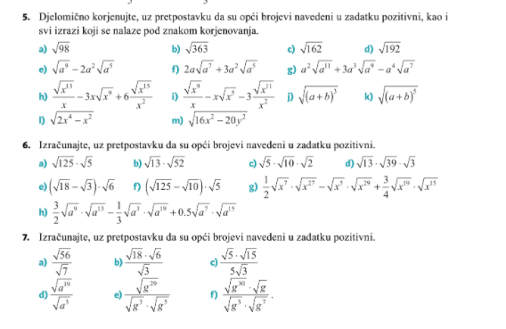
Zadaci za vježbu - za DZ
Str 22
5. b, f, g
6. c, d, f
8. b,d,e
9. b, f
10. a i b

Slide 9
